Slide 1
School Analysis Presentation

Slide 2
agenda
Introduction
Data Preparation
Key Insights
Categorization
Yearly Analysis
Conclusion

Slide 3
Introduction
PROBLEM STATEMENT
To analyze students' academic performance across multiple schools and streams over three consecutive years (2019-2021) to identify top performers, trends, school rankings, and growth patterns, while providing insights into student categorization and school performance to aid in decision-making for students and School Buddy
Goals of the Analysis
The goal of this analysis is to evaluate student performance across schools and streams from 2019 to 2021 to identify top performers, improvement trends, and best-performing schools. It aims to provide insights into cumulative scores, stream-based rankings, and performance bands to help students make informed decisions and guide School Buddy in refining its services.

Slide 4
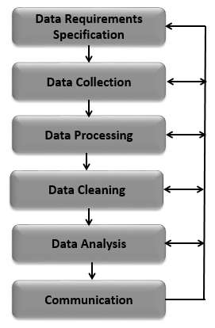
Data Preparation
The raw data was cleaned and transformed to ensure accuracy and consistency. This included handling missing values, standardizing formats, and calculating derived metrics like cumulative marks and year-over-year improvements. The data was then aggregated by schools, streams, and subjects for detailed analysis. keep it in bullet point

Slide 5
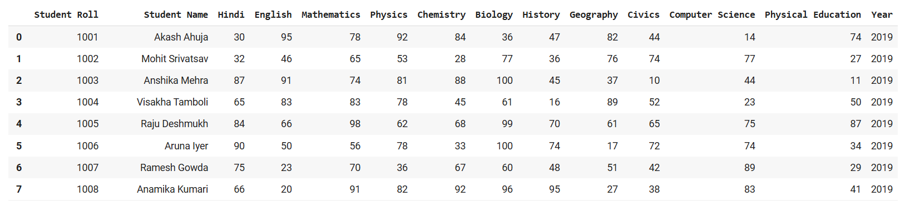
Datasets for all three years

Slide 6
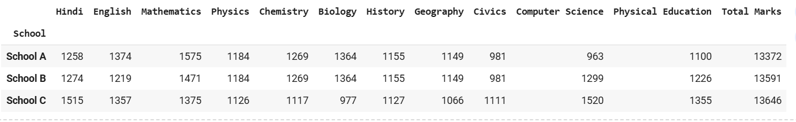
Key Insights
Top Performers Across Schools
The conclusion is that School A has the highest total marks with 13372, followed by School B with 13591, and then School C with 13335. This suggests that School A has performed the best overall.

Slide 7

Rank Comparison and Trends
The conclusion is that Student Roll 1012 achieved Rank 31 in the school rankings with a total of 705 marks in the year 2020.
This data likely represents the student's performance compared to other students across different schools.

Slide 8
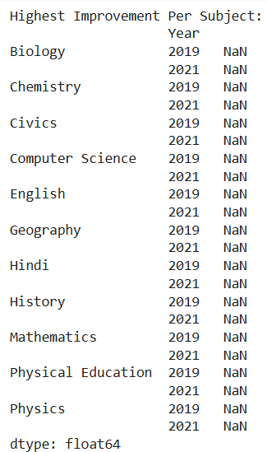
Subject-Wise Improvement Analysis
The output shows that there is no data available for the highest improvement in any subject for the years 2019 and 2021.
The "Nan" values likely indicate that the data is missing or not applicable.
Therefore, it is not possible to draw any conclusions about the highest improvement in any subject based on this output.

Slide 9

Stream-Based Best Schools
The conclusion is that School C is the best school for all three streams: Arts, Science, and Commerce.

Slide 10
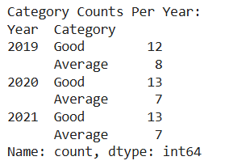
Categorization
Performance Band Classification (Very Poor to Very Good)
The table shows the number of "Good" and "Average" categories for each year from 2019 to 2021.
Here are some conclusions we can draw:
The number of "Good" categories has increased slightly over the years. There were 12 in 2019, 13 in 2020, and 13 in 2021.
The number of "Average" categories has remained relatively stable. There were 8 in 2019, 7 in 2020, and 7 in 2021.
Overall, the data suggests that there has been a slight improvement in the number of "Good" categories over the three-year period.

Slide 11
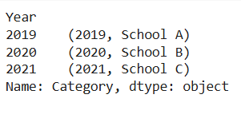
Best Schools for 2019, 2020, and 2021
The output shows that the "Category" column contains tuples representing the year and the corresponding school.

Slide 12

Fastest-Growing Schools (Overall and Streamwise)
Based on the output, the current dataset is not suitable for identifying the fastest-growing school due to missing or inconsistent data. Addressing the identified issues and re-running the analysis will be necessary to obtain accurate results.

Slide 13
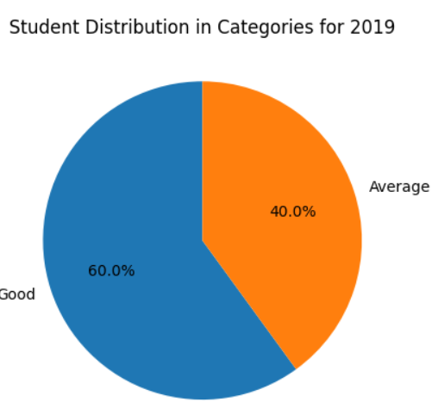
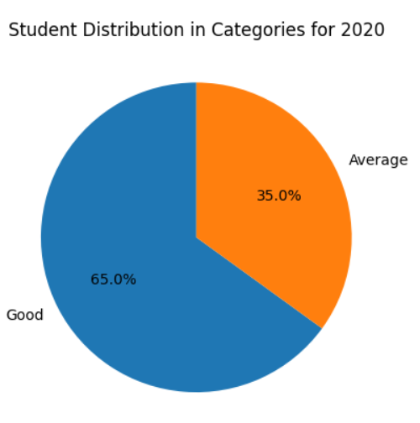
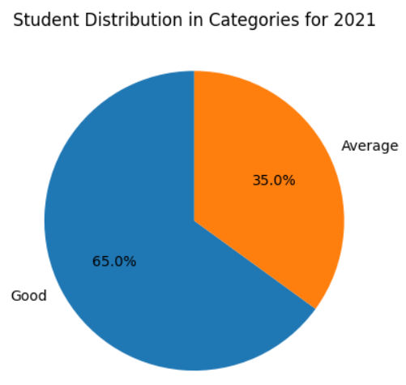
We perform some visualization for better understanding.
PIE CHART
Explanation:-The pie chart will display the distribution of students across different categories (Very Poor, Poor, Average, Good, Very Good) for each year (2019, 2020, and 2021). The chart will show the percentage of students in each category based on their average marks for each year.

Slide 14
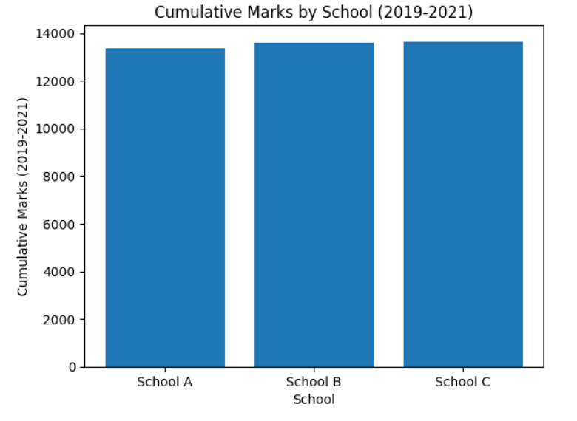
Bar chart
This will show the total cumulative marks for each school from 2019 to 2021, allowing you to compare the performance of each school.

Slide 15
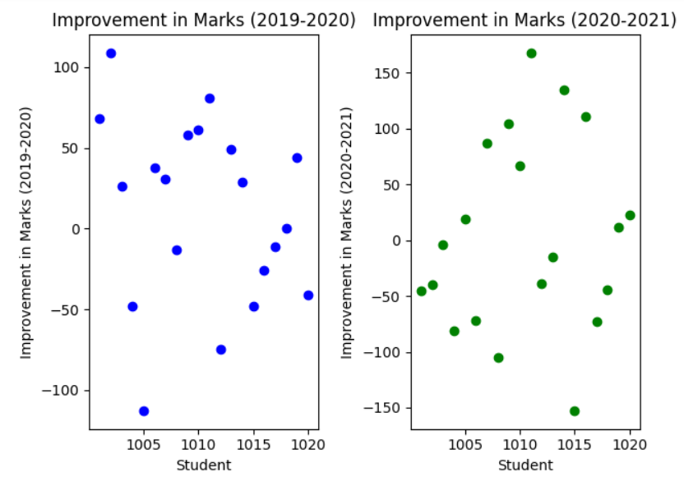
Scatter plot
The scatter plots show student performance improvements between 2019-2020 and 2020-2021. The first plot shows varying growth, while the second highlights continued progress for some and slower improvement for others. These trends can help identify consistently high performers and those needing additional support.

Slide 16
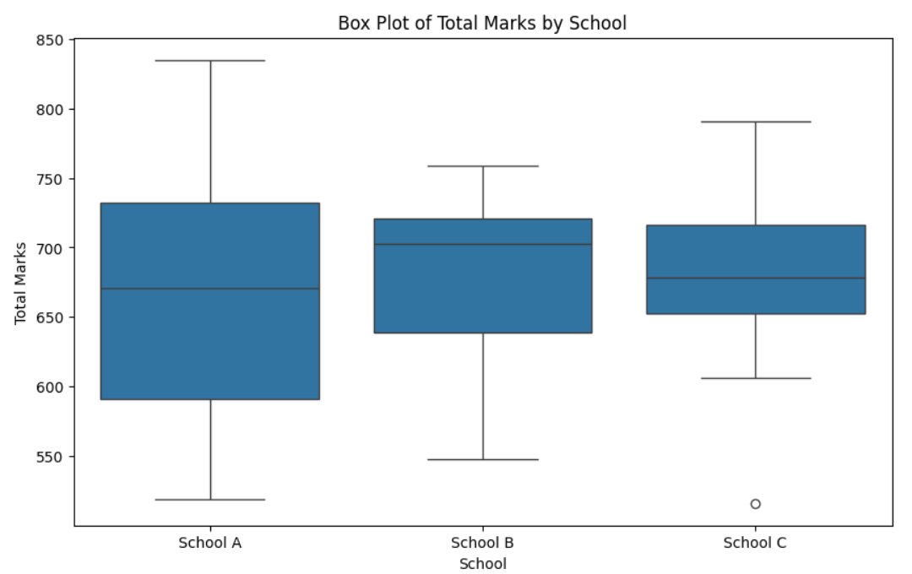
Box plot
Explanation:- The box plot will show how the Total Marks are distributed across different schools. This helps visualize the spread, central tendency (median), and outliers of the marks.

Slide 17
Conclusion
This analysis identified top-performing students, highlighted subject-wise improvements, and ranked schools across streams and years. By categorizing student performance into meaningful bands, we revealed strengths and areas for improvement in each school. The insights provided actionable recommendations for students and schools, helping School Buddy enhance its offerings and guide students toward informed academic decisions

Slide 18
Thank you
Shruti Kumari
9341609928
shrutikumari0146@gmail.com

